Slide 1

Mini Project / Industrial Training Presentation SESSION 2024-25 BCC-351
Department of Information Technology
ABES Engineering College, Ghaziabad, UP
Name-Ravi Bhushan Singh
Class & Section: IT - C
Roll No. – 2300320130191
Admission No. – 2023B0131160

Slide 2
Contents:
INTRODUCTION
Problem statement
Objectives
CHALLENGES
Key features
LIMITATIONS
RESULTS & PROJECT SNIPPETS
Conclusion

Slide 3
DevFlix-MOVIES, SHOWS & WEBSERIES
Dive into the captivating world of cinema with Devflix. Explore a vast library of films, from timeless classics to the latest blockbusters.
Enjoy seamless streaming, personalized recommendations, and a user-friendly interface designed for an unforgettable viewing experience. Discover your next favorite movie on Devflix today.

Slide 4
PROBLEM STATEMENT
In today's digital age, consumers demand convenient and personalized entertainment experiences. Existing movie streaming platforms often lack key features such as robust search and filtering options, personalized recommendations, and user-friendly navigation.
This project aims to address these shortcomings by developing Devflix, a user-centric movie webpage that provides an intuitive interface, advanced search capabilities, and tailored recommendations to enhance the overall movie discovery and viewing experience for users.

Slide 5
OBJECTIVE
This mini project aims to design and develop a user-friendly and interactive movie streaming webpage, named Devflix. The primary objective is to create a platform that provides users with a seamless experience for browsing, searching, and streaming a diverse collection of movies.
The webpage will incorporate key features such as user authentication, movie search functionality, personalized recommendations, and a visually appealing interface to enhance user engagement and satisfaction.

Slide 6
CHALLENGES
Developing a movie webpage like Devflix presented several challenges that required careful consideration and innovative solutions. One primary hurdle was ensuring seamless video streaming capabilities. Integrating a robust streaming infrastructure while maintaining high-quality video playback across various devices and network conditions was a complex task. Additionally, implementing a personalized recommendation system that accurately suggests movies based on user preferences posed a significant challenge. This required careful analysis of user viewing history, ratings, and other relevant data to provide truly tailored recommendations.
Furthermore, creating a user-friendly and intuitive interface that caters to diverse user needs was crucial. Balancing aesthetics with functionality and ensuring a smooth user experience across different devices presented a design challenge. Lastly, the dynamic nature of the film industry necessitated a flexible and scalable architecture. The platform needed to accommodate new releases, updates to movie information, and evolving user demands while maintaining optimal performance and stability.

Slide 7
KEY FEATURES
Extensive movie library: access a wide range of films, from classic hits to the latest releases, across various genres.
Personalized recommendations: receive tailored movie suggestions based on your viewing history and preferences.
User-friendly interface: navigate the platform effortlessly with an intuitive and easy-to-use interface.

Slide 8
LIMITATION
The project may be limited by the availability and quality of movie data.
Access to comprehensive and accurate movie information (synopsis, cast, ratings, etc.) Can be crucial for a successful movie webpage.
Time constraints may limit the level of technical sophistication, such as the implementation of complex algorithms for recommendation systems or advanced security features.
The project may also be constrained by the available technology and resources, such as limited server capacity or bandwidth.
The visual design and user interface may be simpler than a professional platform due to time and resource constraints.

Slide 9

TOOLS AND TECHNOLOGY USED

Slide 10
So, let’s move to see final view of projects:-

Slide 11
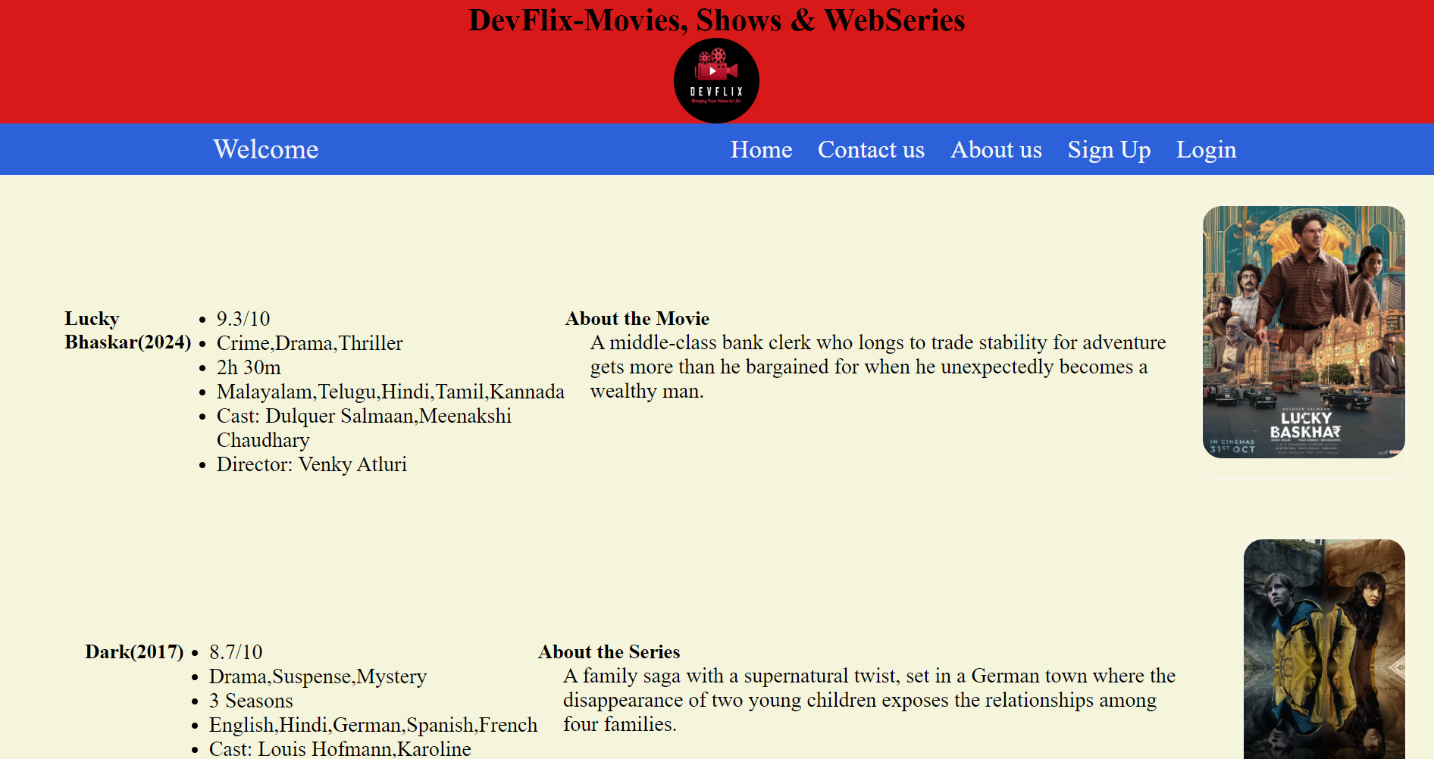
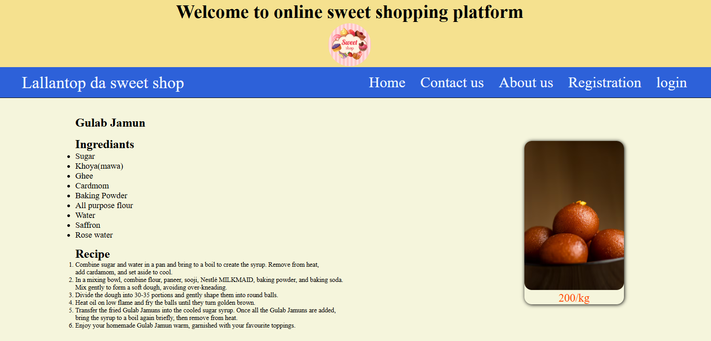

Slide 12
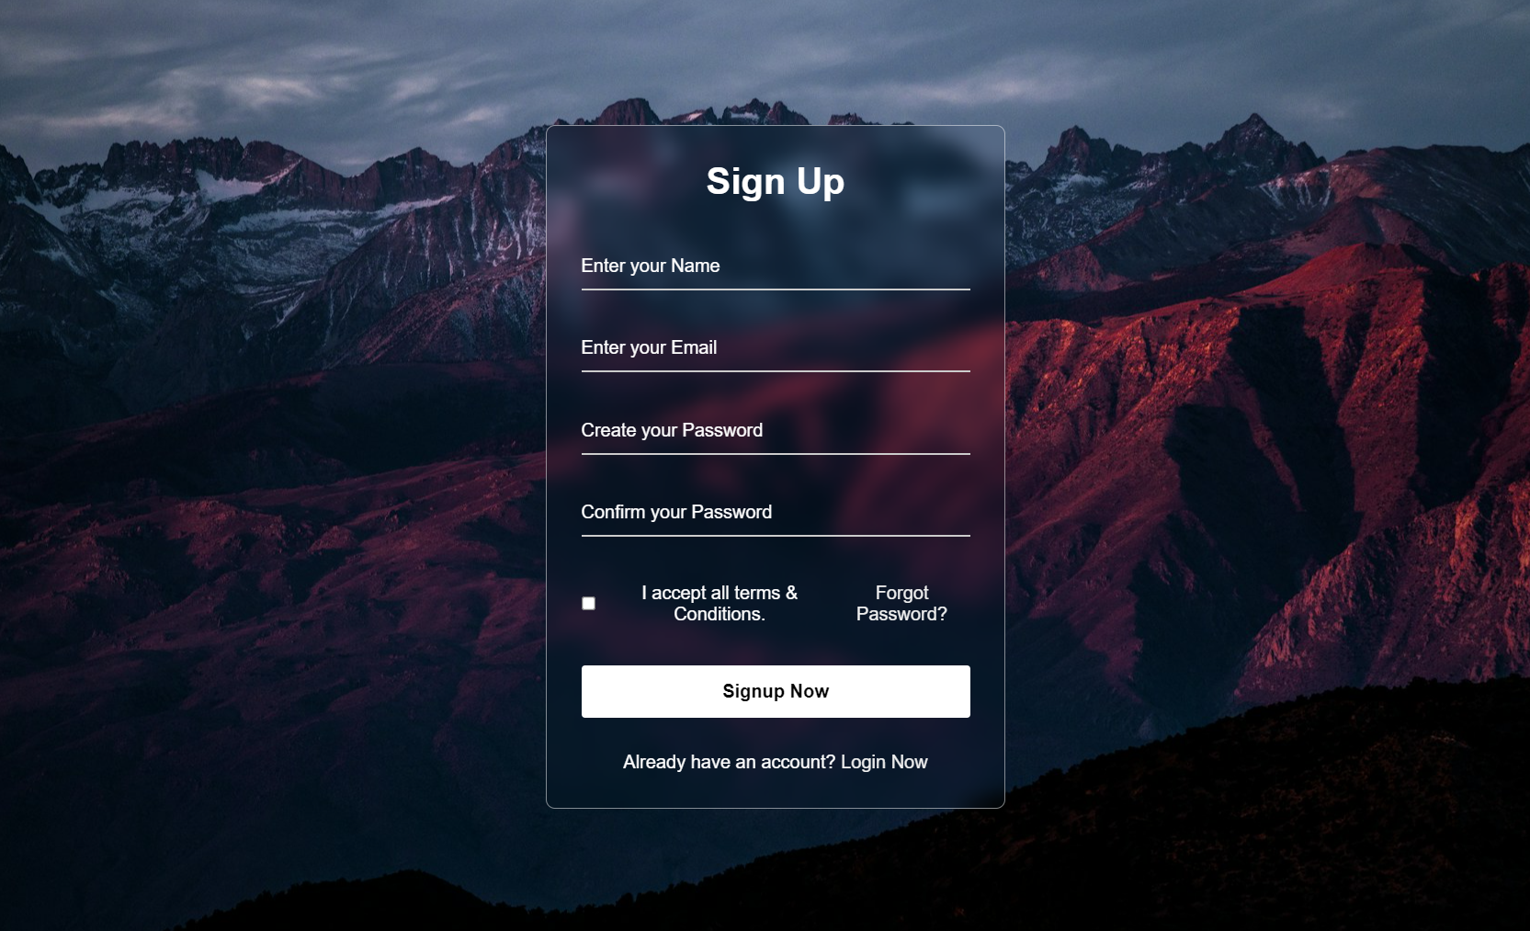
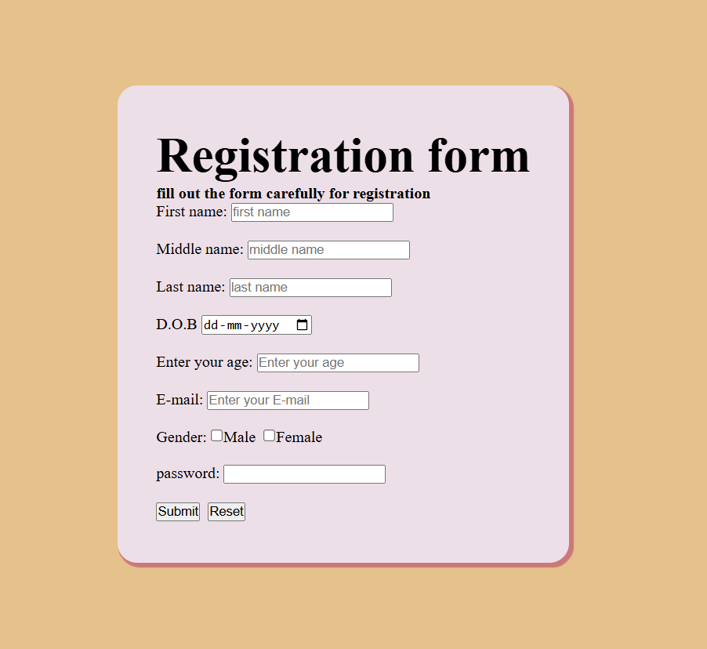

Slide 13
CONCLUSION
Devflix has the potential to become a leading platform in the competitive streaming landscape. By offering a diverse library of films, a user-friendly interface, and innovative features like personalized recommendations and interactive elements, Devflix can cater to a wide range of viewers and provide an engaging entertainment experience. The platform's focus on user satisfaction and continuous improvement will be crucial for its long-term success.
Looking ahead, Devflix can further enhance its offerings by expanding its content library, exploring new technologies such as virtual reality and augmented reality, and strengthening its community features. By embracing innovation and adapting to the evolving needs of its audience, Devflix can solidify its position as a top choice for movie lovers worldwide.

Slide 14
Thank You!
~Ravi Bhushan Singh

